Slide 1
Final Assignment
DATA 824
Zachary Speck
23JUL2023

Slide 2

Source
I went to Kaggle.com. It is a platform run by Google that specializes in data science and machine learning. Its open source so people can add to it and work on projects from it. It provides multiple file formats including .csv. This makes it vary easy to download data on to your computer and from there easily upload to whatever data analysis program you would like to use.

Slide 3
The Data
I wanted to gather data on the Major League Baseball (MLB). I went to Kaggle to see what they had on MLB. Baseball Databank | Kaggle. They had 20 .csv files on different baseball areas. Each one with its own set of variables gathered over several years of MLB play from all players and even managers. All the information is available to the public so there is no concern on privacy or security of the information being gathered.
I decided to download the file on pitching. It had 30 columns of different variables on MLB pitchers from 1933 to 2015. Including 44,140 rows of inputs from 9,126 unique players.
I also downloaded the files on pitching salaries from 1985 to 2015

Slide 4
What’s included.
playerID^ –Player Name
yearID” – Year
Stint* – Different teams, same year.
teamID* – Team Played for
lgID* – League Played for
W -Wins
L - Losses
G – Games Played
GS – Games Started
CG – Complete Games
SHO - Shutouts
SV - Saves
iPouts – Inning Pitched
H - Hits
ER – Earned Runs
HR – Home Runs
BB - Walks
SO - Strikeouts
BAOpp – Batting Average Opp
ERA – Earned Run Average
IBB – Intentional Walks
WP – Wild Pitches
HBP – Hit By Pitch
BK - Balks
BFP – Batters Facing Pitcher
GF- Games Finished
R - Runs
SH – Sacrifice Hits
SF – Sacrifice Flies
GIDP – Ground into Double Plays
Salary- one year salary for the pitcher based on that year.
^-character, “-date, *-categorical, all others are numeric.

Slide 5
Missing Data
Several variables having missing data because back in the beginning days of baseball they were not tracking all of the statistics they do now. So there are several missing values up until the past couple years. The last three variables, SH, SF, and GIDP, I would not use in my analysis because there is so many missing variables and they do not apply much to understanding a pitcher for their pitching skills.
Missing variable are
BAOpp – 1,525 Missing (3%)
IBB ~ 14,600 Missing (33%)
BFP – 239 Missing (1%)
SH ~ 32,900 Missing (75%)
SF ~ 32,900 Missing (75%)
GIDP ~ 43,400 Missing (98%)

Slide 6
What I wanted, and what I did.
I want to see what factors most impact a pitchers salaries.
To get this info I combined the salaries data set and pitching. This way I had all the statistic on the players plus their salaries.
Since the salaries info only goes back to 1985, I have excluded all players before 1985. I also got rid of the statistics/variables for pitchers batting ability. Something I did not want to add into the mix since pitchers no longer bat.

Slide 7
New Data
This left me with 11,528 observations.
I also created three new rows.
Win Percentage, taking wins givided by game played.
Loss Percentage, taking losses and dividing by game played.
Note wins plus losses does not normally equal game played. Often pitchers do not get win or loss because the game is tied when they are pulled.
Salaries adjusted for 2015. Here I ran code to adjust older salries for 2015 inflation. That way all salaries were equal.

Slide 8
The Analysis
First I wanted to gather information on the adjusted Salaries column as that is my dependent variable.
I collected a series of data plus graphs to represent the data from information I have learned in the class over the semester.
Next I did a correlation plot to see the comparisons between the updated salaries and the variables/player statistics, to see which has the strongest correlation to salaries.

Slide 9

Salary Summery

Slide 10
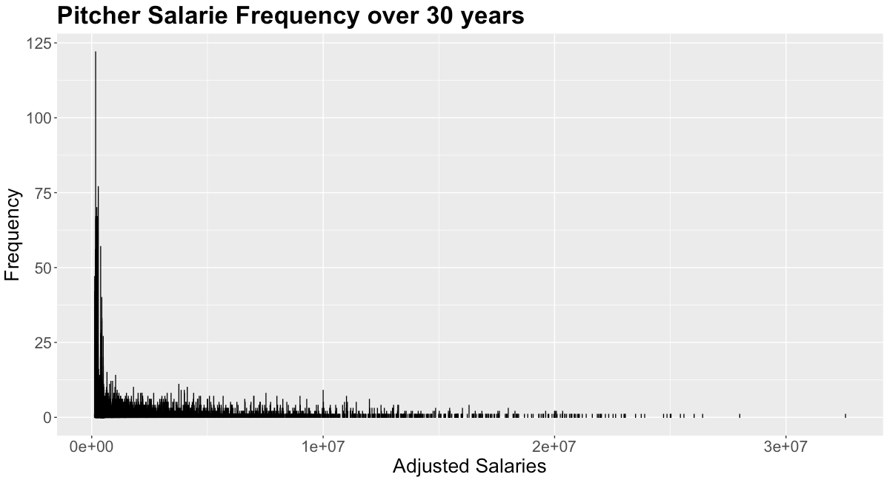
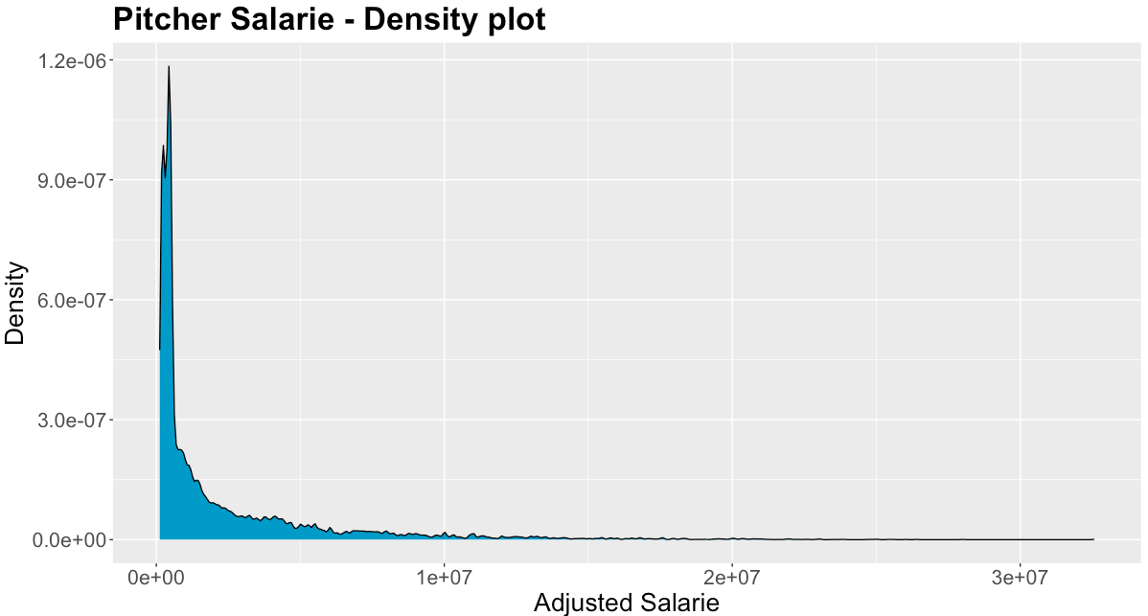
Histogram and Density Plot

Slide 11
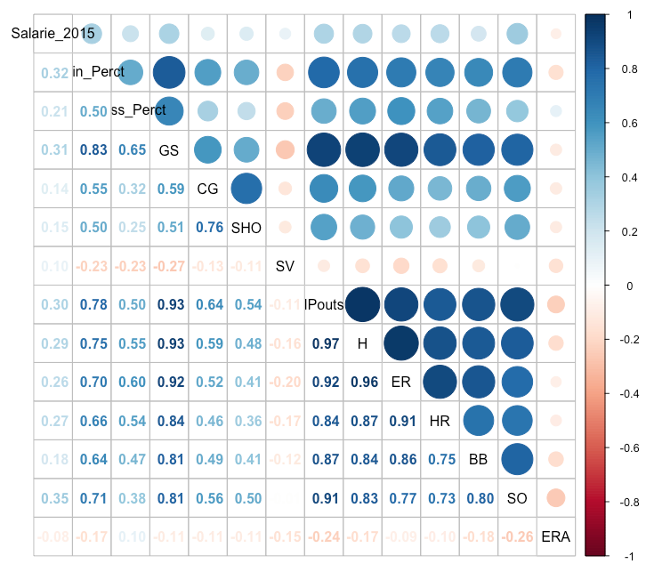
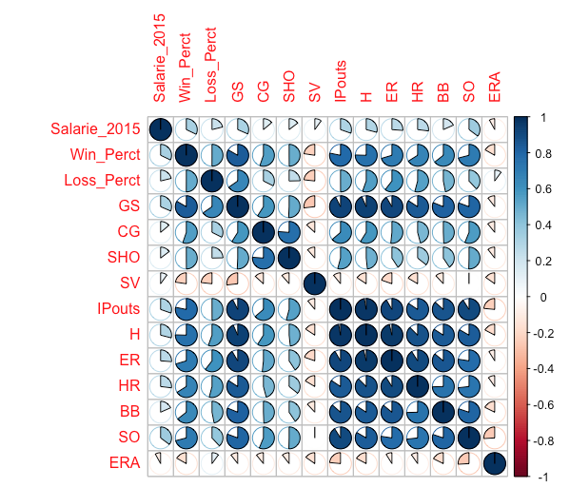
Correlation Plot

Slide 12
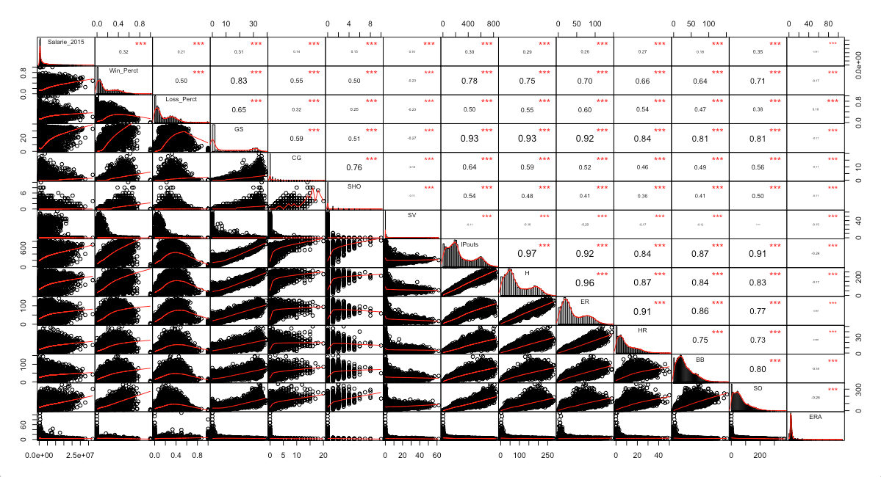
Different correlation plot with histogram

Slide 13
Results
From the correlation plots I was able to see that the statistics Win Percentage, games saved, IP Outs and Strike outs had the highest correlation to the Salaries of the player. All of them had over 30% correlation.
Out of those top statistics, if I had to objectively pick the best one I feel I would choose win percentage as I feel it is the most fair in showing who the best pitchers are. With this I further ran a couple more charts to show Salary and Win Percentage together.
I was surprised that ERA, a statistics used in Baseball to determine who the best Pitcher is, did not have a correlation to salary almost at all.

Slide 14
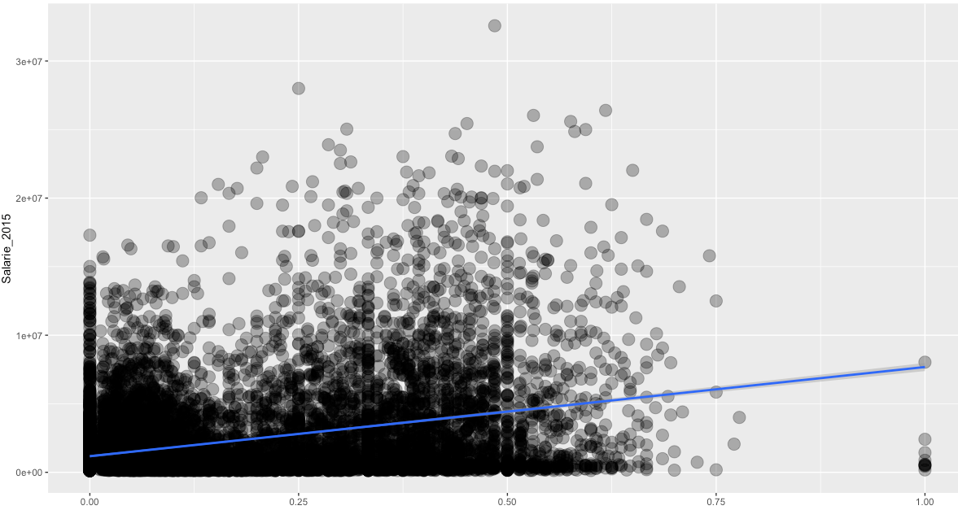
Plot w/ Win Perct vs Salary 2015

Slide 15
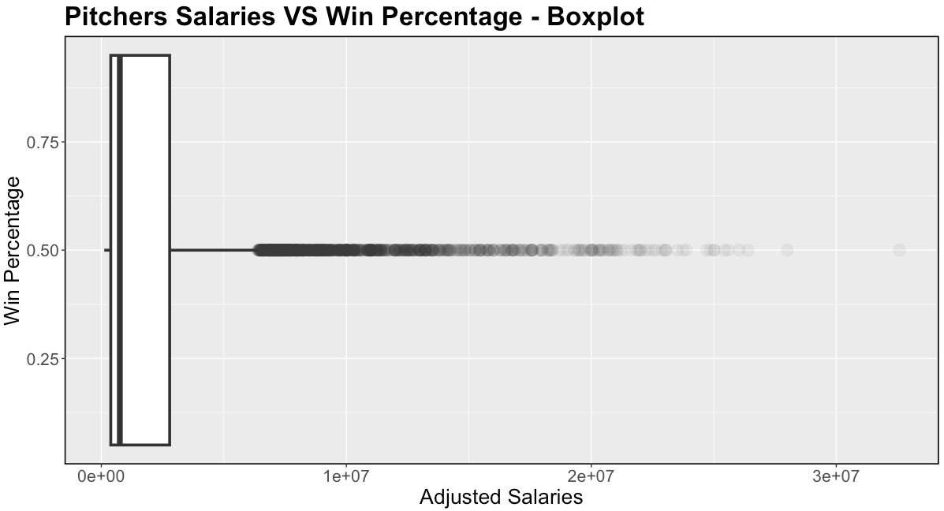
Boxplot with Win Perct and Salary 2015

Slide 16
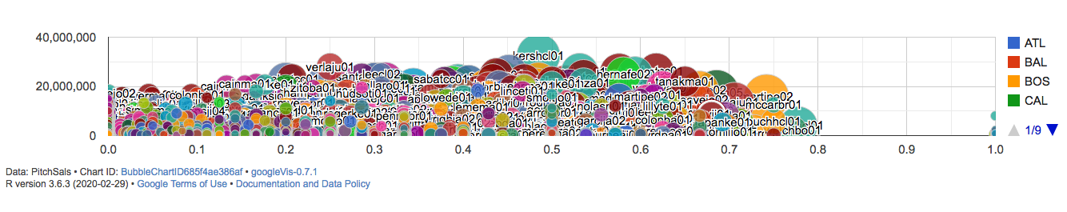
Google Vis Bubble Chart

Slide 17
Conclusion and Next Steps
While Win percentage was a good variable in correlation, I don’t think it would be a good prediction tool. I tried to run the prediction Model in R but had an error I was unable to fix. I added it with the upload info to GitHub and maybe someone out there can show me where I went wrong. But I am sure the lowest RMSE would be a combination of few different variables.
Also there is a couple players who had 1.o win percentage because they only played in only a few games. I think in order to really help this model I would add another step to make sure Games played was above a certain threshold, like 5 or 10 games minimum. I think that would clear up a lot of data, and take outliers out for players pulled up from minor league in the middle of the season, or players hurt that did not play a full season.

Slide 18
Shiny
I was unable to make the shiny app work with my outdated computer/ r studio. But I still wrote the program for the app, unsure how it turned out. It is part of my upload to GitHub.
The goal of the app is to be able to see all the statistics versus the adjusted salary of all the players. You can use the left side for a drop down to choose real quick what you want to look at and it will create a scatter plot with the y axis being salary and the x axis being what the user chooses from the list. It’s a good way for a user to get a quick look at how the correlation will line up.

Slide 19
GitHub
https://github.com/zjspeck/test-repo/upload/main
I was unable to push from my system to github so I uploaded the file directly. I was able to access on terminal and link my computer but disk space was running low and would fail with the upload. Hope I have gotten everything that you needed. Please let me know if you want me to demo straight anything I was unable to upload due to an old computer/operating system. Thank you for baring with me. I enjoyed the class.

